Slide 1
SEND Interventions at River View Primary & Nursery School
Staff Training Day
Monday 4th January, 2016

Slide 2
The Listening Program
The Listening Program®(TLP) is a music listening method, personalized to improve brain fitness at any age or level of ability.
Used and trusted by hundreds of thousands of people in over 35 countries, TLP is offered through our international network of trained providers.
Psycho-acoustically modified music which works on the idea of the neuroplasticity of the brain
https://www.youtube.com/watch?v=iXMJIyN3f-0

Slide 3
TLP has global effects on the brain, and is commonly used to support changes in a wide range of brain performance areas:
Executive Function
Communication
Auditory Processing
Social & Emotional Function
Stress Response
Motor Coordination
Creativity

Slide 4

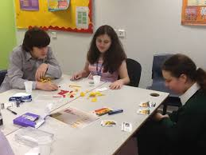
Lego Therapy

Slide 5
What is Lego therapy?
LEGO-based therapy is a social development program to improve effective social development.
The children work in groups of 3 and take on defined roles as
Engineer
Supplier
Builder
The children rotate through these roles.
https://www.youtube.com/watch?v=1SVqfOSSzjs

Slide 6
What skills do the children develop?
Collaborative work
Division of labour
Sharing
Turn-taking
Emphasis on verbal and non-verbal communication
Eye contact
Social problem-solving
Impulse control
Attention and concentration
Giving clear and understandable instructions
Taking the lead

Slide 7
Speech & Language Therapy
The school has identified quite a challenge with Speech, Language and Communication Needs.
The head teacher has provided budget for us to directly employ speech and language therapists who can support teachers and children. We have employed therapists through West Midlands Independent Speech and Language Therapy Services – Ina Strathausen and Lisa Christophorou.
SEND team are very experienced with speech and language difficulties and have over 25 year experience of working with children with very severe difficulties.
ICAN licensee and Communication Champion.

Slide 8

Superflex – Social Communication
Superflex ®: A Superhero Social Thinking Curriculum provides educators, parents and therapists fun and motivating ways to teach students with social and communication difficulties (undiagnosed or diagnosed, such as Asperger Syndrome, ADHD, high-functioning autism or similar). The three part cognitive behavioural curriculum helps students to develop further awareness of their own thinking and social behaviours and learn strategies to help them develop better self-regulation across a range of these behaviours.
Improves learning behaviours, communication and self-awareness.

Slide 9
Dyslexia/SpLD Group
Children with specific difficulties in literacy or Dyslexic tendencies need lots of multi-sensory, repetitive learning opportunities in order to over-learn and embed spellings, words and literacy skills.
Children have the opportunity to attend daily 30 minute sessions with different teaching techniques than those in the class, aimed at helping the children overcome their difficulties in literacy development.
Files should come home daily, and please support children with spellings, word recognition, reading, handwriting etc.. Bookmarks containing their weekly spellings are sent back with them to their classroom, so that they can be monitored and embedded.

Slide 10
Targeted Play
Children with a range of challenges and needs ranging from specified special educational needs to social and emotional challenges attend these groups. Around 12 to 15 children attend for an hour weekly.
Children have individual targets, and play opportunities are offered to facilitate children achieving these targets without them realising they are doing so.
A relaxed opportunity for skill acquisition ending in a drink and snack.

Slide 11

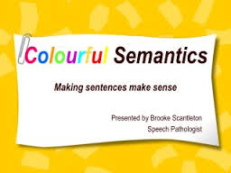
Colourful Semantics
A highly visual method of supporting children to write more complex and meaningful sentences that make sense, and extend their vocabulary use.

Slide 12
Precision Teaching
Children receive short 20/30minute 1:1 sessions around specific targets in English, Reading or Maths with adults.This might be ongoing or very short term around a specific difficulty or learning objective.

Slide 13
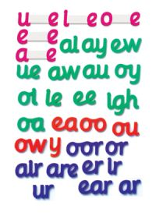
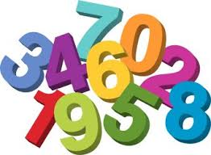

Small group Maths and English Interventions
Children receive small group teaching around specific Maths concepts or aspects of English. They are taught strategies that they can utilise to then take this learning back into the classroom environment.

Slide 14
Positive Play
1:1 focused and targeted play with one adult to one child. Children are able to play and explore their feelings and discuss their needs.
Mrs Matkin conducts these specialist sessions.

Slide 15

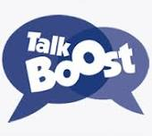
Talk Boost/Early Talk Boost
This is an evidence-based researched intervention for those children who have mildly delayed speech, language and communication.
The children receive 3 weekly sessions of 45 minutes in a ratio of 1:6 for Talk Boost and 3 sessions of 30 minutes in a ratio of 1:8 for Early Talk Boost.
This is a specialist program designed by the national Speech and Language charity, ICAN.
Children will bring home workbooks and books to share with you. Please help the children complete the tasks together, and ensure the books are returned to school daily. Children generally make between 6 and 18 months progress in their language skills through this intervention.

